Slide 1
Agitation, Concentration and Surface Area

Slide 2
In this lesson we are going to look at how to:
1. | Identify the effect of agitation on the rate of reaction.
2. | Identify the effect of concentration on the rate of reaction.
3. | Identify the effect of surface area on the rate of reaction.

Slide 3
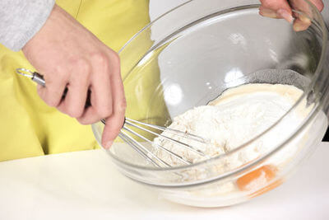
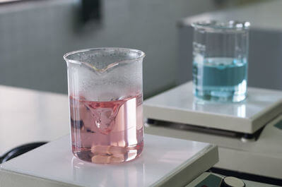
Agitation is just the scientific way of saying mixing.
We say that something that has been mixed thoroughly is uniform. This means that one part of the mixture will look exactly like another.

Slide 4
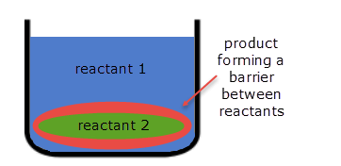
Agitation ensures that all the reactants are kept in contact by preventing the build up of products around them.
The product forms in the area where reactants 1 and 2 meet. Without agitation, this product will form a barrier that reduces collisions between the two reactants.

Slide 5
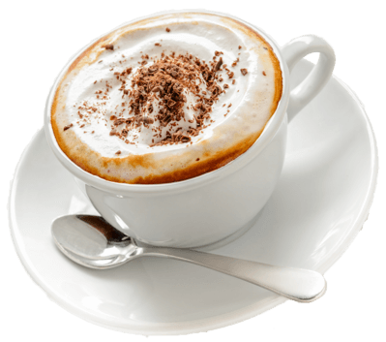
When you add sugar to a hot drink, you usually stir it in. This is because agitation speeds up the dissolving process!
Dissolving sugar requires collisions between the sugar and water. If you do not agitate the drink, the dissolved sugar would surround the solid sugar, and shield it from collisions with the water!

Slide 6
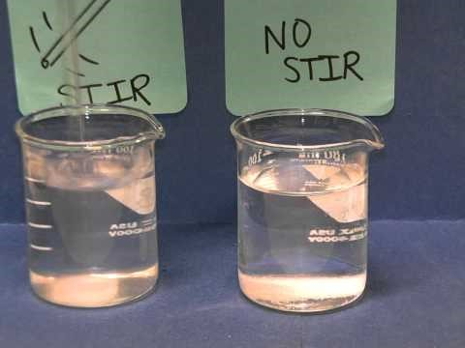

Slide 7
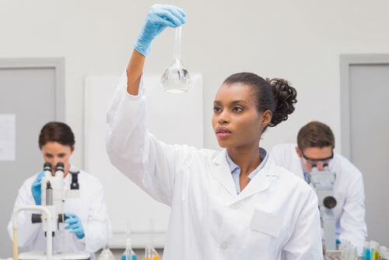
Concentration is a measure of how many reactants are in a particular volume of liquid or gas.

Slide 8
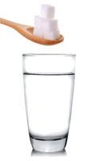
It is important to remember that concentration is more than just how much stuff there is!
Concentration also depends on how much space the stuff is kept in.
If you have 1 sugar cube in 1 cup, or if you have 100 sugar cubes in 100 cups, there is still only 1 cube in each cup!

Slide 9
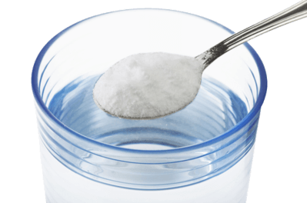
If you were to pour a single teaspoon of salt into a glass of water, the concentration would be low.
If you were to pour an entire salt shaker into the same glass of water, the concentration would be high.
A solution with a high concentration is concentrated while a solution with a low concentration is dilute.

Slide 10
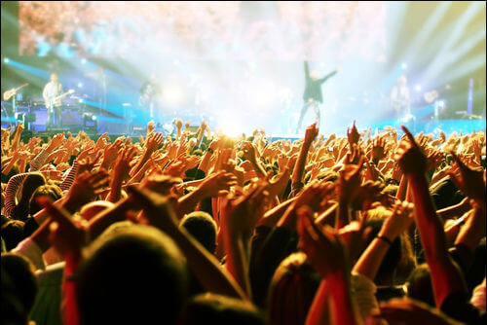
The higher the concentration of reactants, the more collisions will occur.
You are more likely to bump into someone in a crowded room compared to a nearly empty room!

Slide 11

The lower the concentration of reactants, the fewer collisions will occur.
You are less likely to bump into someone in a nearly empty room compared to a crowded room!

Slide 12
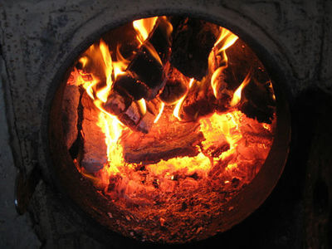
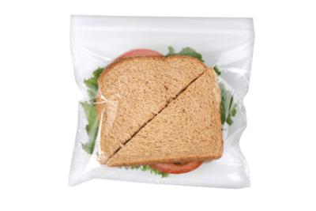
When you want to increase the speed of the reaction which makes the flames in your fireplace, you increase the concentration of fuel by adding more wood.
When you want to decrease the speed of the reaction which makes your food go stale, you decrease the concentration of oxygen by putting it in an air-tight bag.
Both of these are examples of how we use concentration everyday to control the rate of reactions!

Slide 13
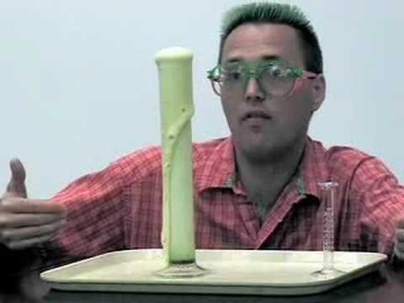

Slide 14
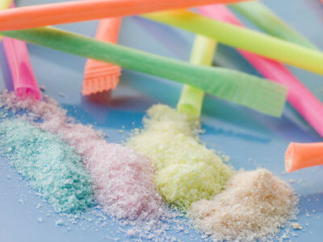
Collisions occur on the surface of solid reactants. A larger surface area means more collisions can occur, which would increase the rate of reaction.
Sherbet fizzes in your mouth because it is a powder. If you had a solid block of sherbet, it would be very disappointing!

Slide 15
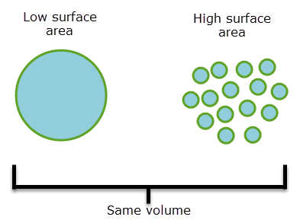
When you have a solid piece of reactant, the centre can't react until the surface has reacted first.
By breaking it into smaller pieces, you reveal more surface that can react at once!
In the diagram below, both reactants have the same volume, but the smaller pieces have considerably more surface area.

Slide 16
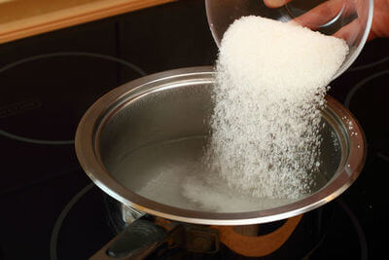
Have you ever noticed how many everyday substances are powders?
It's so they react faster and you can use them as soon as possible!
Coffee, cocoa, sugar, salt, flour, baking powder, flavour sachets, drink sachets, and many more!

Slide 17
